Slide 1


Slide 2



Slide 3

GENERAL OVERVIEW
Numbers of Articles: 1,391,033
Numbers of Authors: 351,584
Numbers of Publications: 43,045
Numbers of Tags: 95

Slide 4
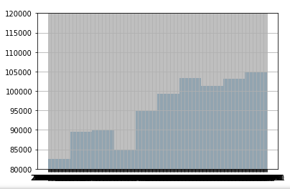
ARTICLES PER DATE

Slide 5
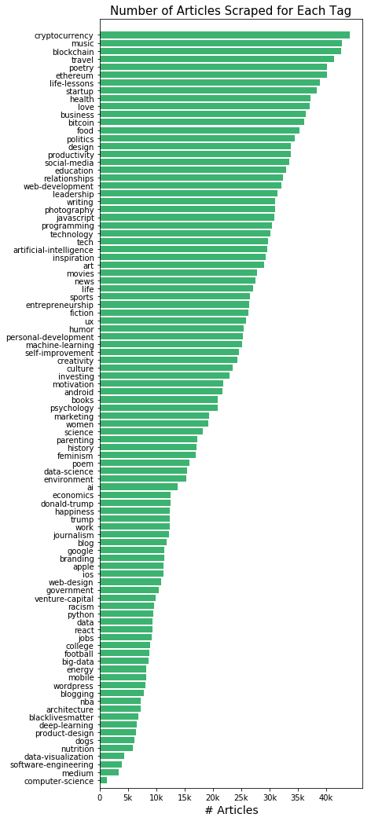
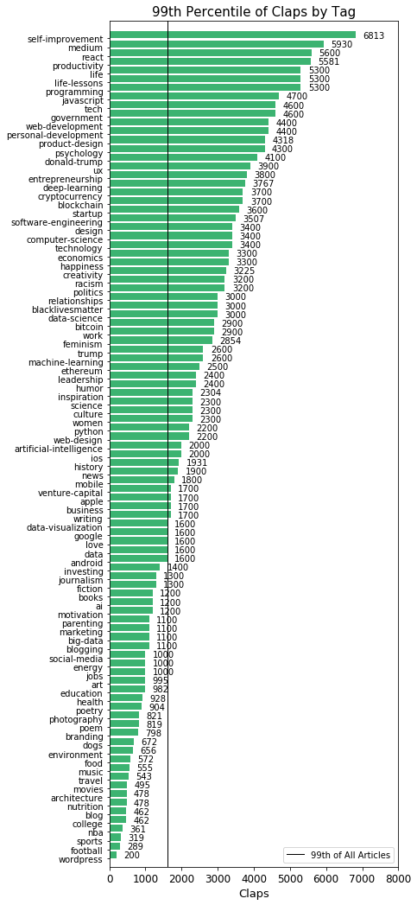
TAGS

Slide 6
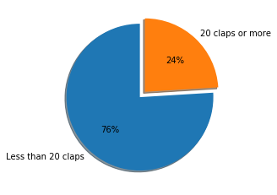
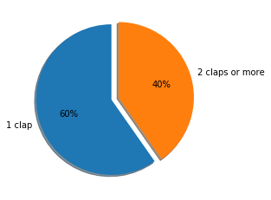
CLAPS

Slide 7

CLAPS BREAKDOWN
Total n. of claps: 62,535,925.0
Max claps for one article: 172,000.0
Max claps for one author: 755,499.0
Average number of claps: 65.58
Median Number of claps: 0.0
Standard deviation of the umber of claps: 673.4
90% of articles obtain 104.0 claps or less
70% of articles obtain 8.9 claps or less

Slide 8
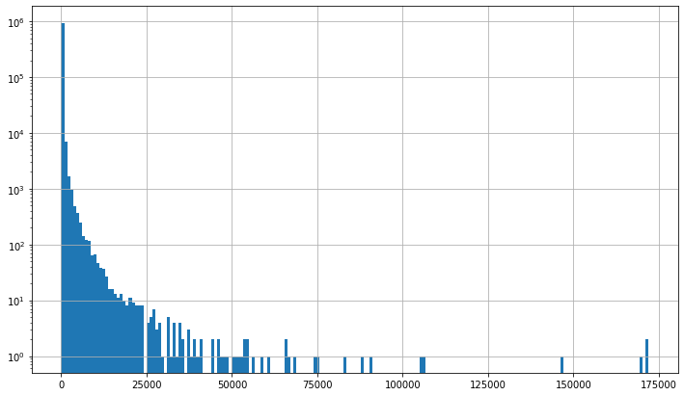
CLAP DISTRIBUTION

Slide 9

Does the Top 1% have it all?
99% of the articles have 1000.0 claps or under
Number of articles with more than 1000 claps: 8,361
Number of articles with 1000 claps or less: 945,163
99% of the claps belong to 0.88% of the articles

Slide 10
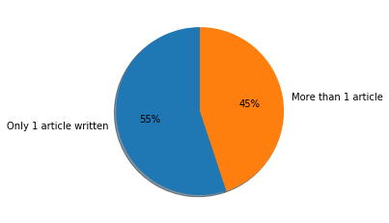
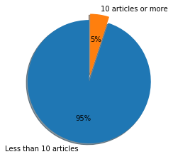
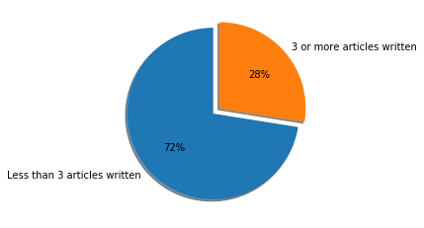
ARTICLES PER AUTHOR
Average number of articles per author: 3.17
Median number of articles per author: 1.0
Max number of articles per author: 1039
Only 5% of the authors write more than 10.0 articles
Only 44.9% of the authors write more than 1 article

Slide 11
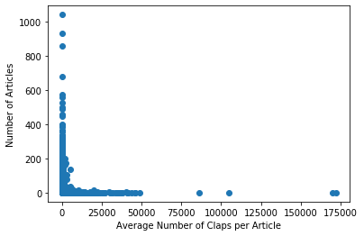
AVG. CLAPS PER # OF ARTICLES WRITTEN PER AUTHOR
Correlation between average claps & number of claps: 0.0035

Slide 12
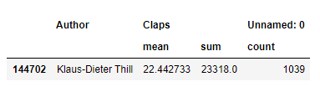
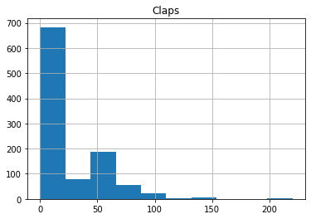
WHAT YOU NEED TO DO TO SUCCEED
Write 10 Articles minimum – top 5% of authors
Write about Self-Improvement , medium, productivity or programming
Persevere and do not lose hope
Do it because you love doing it – there’s no guarantee of success
Understand that most of your articles won’t get a lot of traction, only some of them might take off

Slide 13


Slide 14
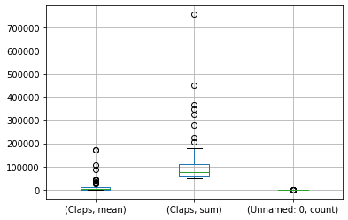
TOP 100 AUTHORS WITH THE MOST CLAPS

